Slide 1
Functional Programming
In the imperative domain.

Slide 2
Modus Operandi
To become and to be better Programmers.
New Modes of Thought – The Sapir-Whorf Hypothesis – The Language you Speak both externally and internally, shape or define the thoughts that you are capable of having.
By learning first the principles of Functional Programming, a set of Functional Languages, and paths toward Imperative Application, we give ourselves a second inner-language, making us better programmers.
Modern Design – Thought Leadership –
Most modern Programming Language Innovations come from the Functional Discipline (Functional Programming Renaissance)

Slide 3
How?
An Intimate Familiarity with the Functional Domain.
A Multi-Part Presentation Delivery and Subsequent Literature

Slide 4
Outline
Introduction
Why Functional Programming, Attractions, Motivations
History of Functional Programming
Concepts, Principles, Foundations, and Techniques
Mathematical Foundations
Theory of Recursive Functions
Category Theory
Lambda Calculus
Principles of Functional Programming
Immutable, Stateless (Pure Functional)
first-class functions
higher-order functions
pure functions
Recursionl
ist processing
lazy evaluation
Functional Languages
Old School
LISP
Scheme
ML (Standard ML, Ocaml)
Haskell
New School Functional Programming
F#
Scala
Clojure
Erlang
Imperative Languages in Functional Style (ALL MCC Lang)
C++ in Functional Style
C# in Functional Style
Java 8 in Functional Style
Ruby in Functional Style
Python in Functional Style

Slide 5
Todays Talk:
Higher Order Functions
C++ in Functional “Style”
Video: Erik Meijer, Simon Peyton Jones - Haskell is useless
Video: Brian Beckman: Don't fear the Monad

Slide 6
A Brief History of Functional Programming
The Land Before Time (t < 00:00:00 UTC, 1 January 1970)
Dinosaurs walked Hand in Hand with Man and… Other Dinosaurs
The Death of Functional Programming
The Renaissance

Slide 7
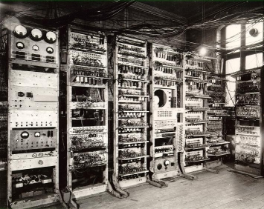
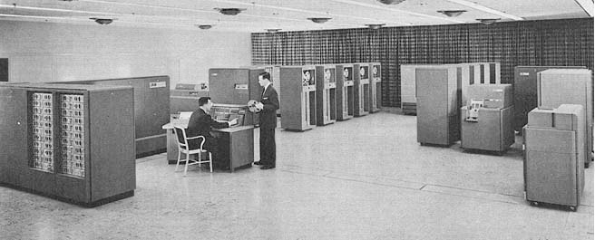
The Land Before Time
LISP, Cobol, Fortran => All lived together in a happy, Galapagos like kind of peaceful coexistence.
Fortran – 1957, John Backus
LISP – 1958, John McCarthy
Cobol – 1959,

Slide 8

The Death of Functional Programming – The 1980’s
The Japanese 5th Generation Project in the 1980’s.
A Super-Computer to compile Functional languages, without state. That…. DID NOT WORK.
The Evolution and, eventual ‘take-over’ of Strongly Typed Languges: C, C++, Objective-C, Pascal

Slide 9
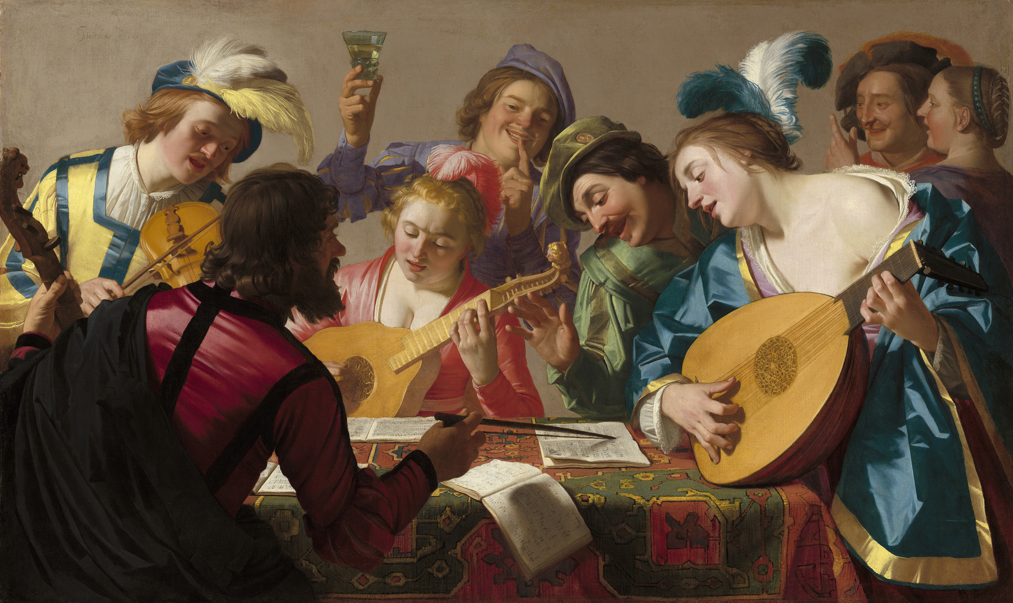
Functional Renaissance
We are WITHOUT A DOUBT experiencing a kind of a Renaissance in the Functional Programming Discipline
Scala, 2004
F# (Don Syme, Circa 2005)
C# introduces LINQ,
(.NET Framework 3.5, Anders Heijelberg, 2008)
Clojure (2008)
C++ 11
Java 8 (2014)
C++ 14
C++ 17

Slide 10
Higher Order Functions
Takes one or More Functions as an Argument
Returns a Function as a result
Examples of Higher Order Functions
Map - applies the function parameter to each item in a list parameter, and return the result as a list
Reduce – The Reduce function (AKA Fold) reduces a list to a single value.
Pipeline – Pipelining is about composing functions to form a new Function.

Slide 11
Functional Programming in C++
C++ 11 and C++ 14 added new Language Features that better enable the developer to express a functional style in the language
New language constructs
auto keyword
Functional data types AKA Function Objects AKA lambdas
Functional Combinators
C++ and Functional Programming:
"C++ is not a functional programming language. C++ is a multi-paradigm programming language that supports functional style programming and other useful styles of programming. If what you are looking for is something that forces you to do things in exactly one way, C++ isn't it. There is no one right way to write every program - and even if there were there would be no way of forcing programmers to use it.

Slide 12
Movie Time
Haskell is “USELESS”
Don’t Fear the Monad!

Slide 13
Functional C++ - Functional Data Types (Lambdas)

Slide 14
Functional C++ - Functional Combinators

